Slide 1
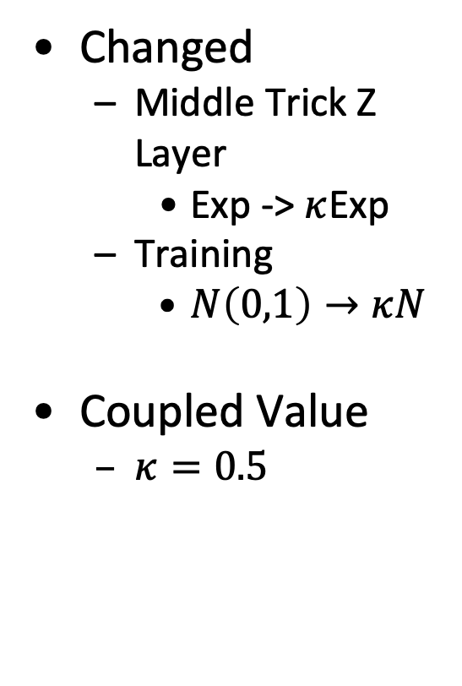
Prototype Coupled Gaussian Latent Layer
Gaussian
Coupled Gaussian
8/9/20
Add Title
<number>

Slide 2
Coupled VAE modifies latent layer:
# CoupledExp uses the coupled Exp function
random samples from a coupled Gaussian
Question is:
random generates a random variable
should confirm that # is transforming sd back into the variable z space
it seems odd that random isn’t inserted at z; this may be an artifact of this particular code rather than the structure of the standard VAE algorithm
8/9/20
Add Title
<number>

